Slide 1

May. 13th 2024
RAGE
Energy Consumption Prediction Framework in Model-based Development for Edge Devices
Yue Hou Azumi Takuya
Saitama Univ. Saitama Univ.
Japan Japan
Notes:
Hello, everyone. My name is Yue Hou, a graduate school student from Saitama University in Japan.
Today, I’ll give a presentation on my research which names [Energy Consumption Prediction Framework in Model-based Development for Edge Devices}

Slide 2
Outline
Background
Proposed Method
Evaluation
Conclusion

Slide 3
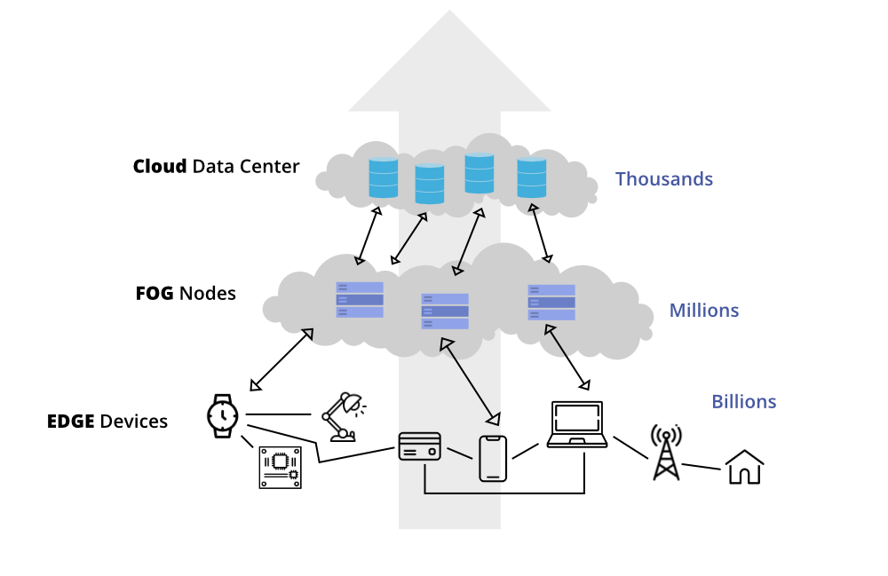
Edge Devices
[Background]
Development of Edge Devices
The count of devices is increasing
Systems is becoming complex
Development of Systems on Edge Devices
The cost is becoming significant
The reusability of the code developed with traditional method is limited

Slide 4




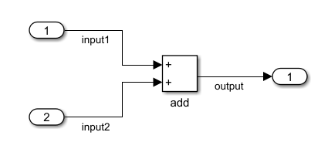
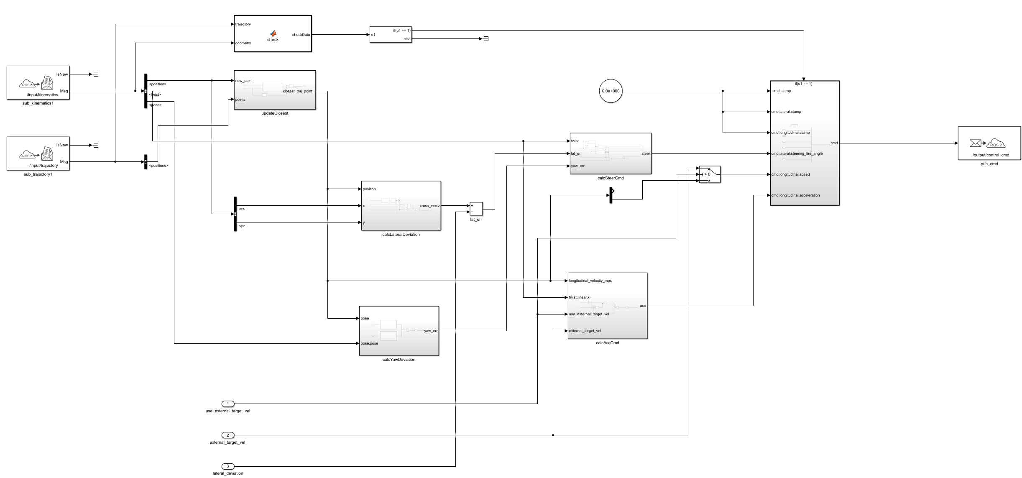
Model-based Development (MBD)
[Background]
MATLAB/Simulink
MATLAB: a programming and numeric computing platform developed by MathWorks
Simulink: a block diagram environment for Model-based Development integrated with MATLAB

Slide 5
Model-based Development (MBD)
[Background]
V-Model
A structured approach to system development that mirrors the stages of development with corresponding testing phases
Required Specifications
System Test
Basic Design
Integration Test
Detailed Design
Unit Test
Code Generation
Notes:
The V-Model in Model-Based Development
The V-Model is a structured approach to system development that mirrors the stages of development with corresponding testing phases, forming a V-like diagram. It is especially prevalent in Model-Based Development (MBD), where the emphasis is on developing and validating system models early in the design process.

Slide 6
Model-based Development (MBD)
[Background]
Design Phase
Requirements Analysis
Basic Design: simulation based on model (Energy is ignored)
Detailed Design
Required Specifications
System Test
Basic Design
Integration Test
Design Phase
Test Phase
Detailed Design
Unit Test
Code Generation
Notes:
The V-Model in Model-Based Development
The V-Model is a structured approach to system development that mirrors the stages of development with corresponding testing phases, forming a V-like diagram. It is especially prevalent in Model-Based Development (MBD), where the emphasis is on developing and validating system models early in the design process.

Slide 7
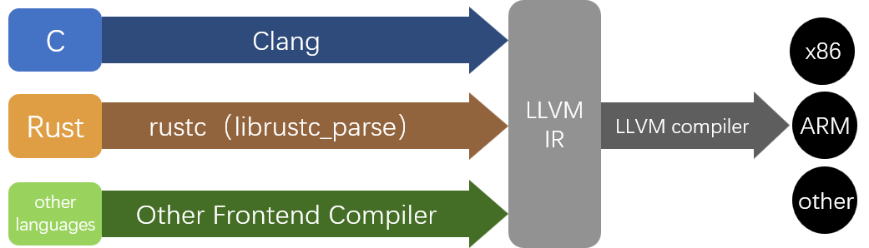
Low Level Virtual Machine Intermediate Representation （LLVM-IR）
[Background]
LLVM-IR
A low-level programming language used as the primary IR within the LLVM compiler framework
Serves as a bridge between high-level languages and the machine code, enabling code analysis and transformation
Notes:
The V-Model in Model-Based Development
The V-Model is a structured approach to system development that mirrors the stages of development with corresponding testing phases, forming a V-like diagram. It is especially prevalent in Model-Based Development (MBD), where the emphasis is on developing and validating system models early in the design process.

Slide 8
Contribution
[Proposed Method]
［Contribution1］ A schema is proposed to describe the energy consumption of instructions
［Contribution2］ A method is proposed for extracting the working portion from generated code and transforming it into LLVM-IR
［Contribution3］ A software tool is designed to predict model energy consumption

Slide 9
Contribution
[Proposed Method]
［Contribution1］ A schema is proposed to describe the energy consumption of instructions
［Contribution2］ A method is proposed for extracting the working portion from generated code and transforming it into LLVM-IR
［Contribution3］ A software tool is designed to predict model energy consumption

Slide 10
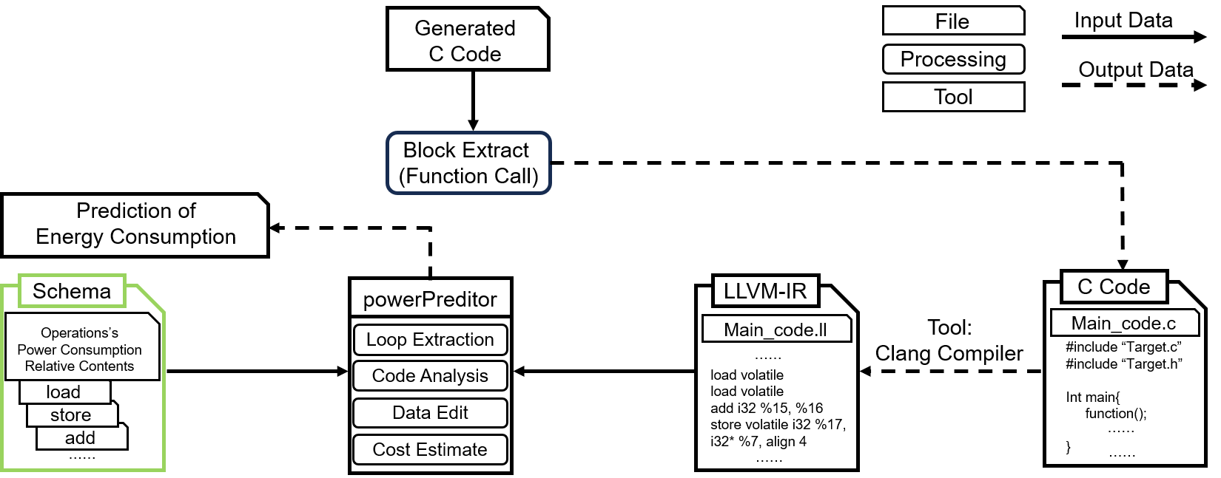
Energy Consumption Description Schema
[Proposed Method]
Schema
Provide a universal framework to describe energy consumption for any given instruction

Slide 11
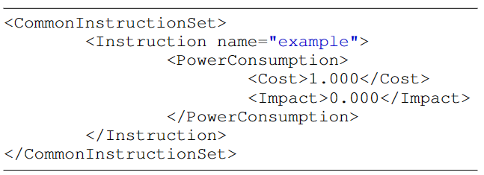
Energy Consumption Description Schema
[Proposed Method]
Three-Tier Structure
Top Layer
CommonInstructionSet
Middle Layer
Instruction
Bottom Layer
PowerConsumption

Slide 12
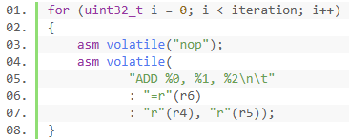

Energy Consumption Description Schema
[Proposed Method]
Acquisition Method
Time and Energy
Execution time is directly linked to energy consumption
Method
A cyclic execution approach is used for better precision in predicting individual instructions' time and energy use
Empty Body
Measured Body

Slide 13
Contribution
[Proposed Method]
［Contribution1］ A schema is proposed to describe the energy consumption of instructions
［Contribution2］ A method is proposed for extracting the working portion from generated code and transforming it into LLVM-IR
［Contribution3］ A software tool is designed to predict model energy consumption

Slide 14
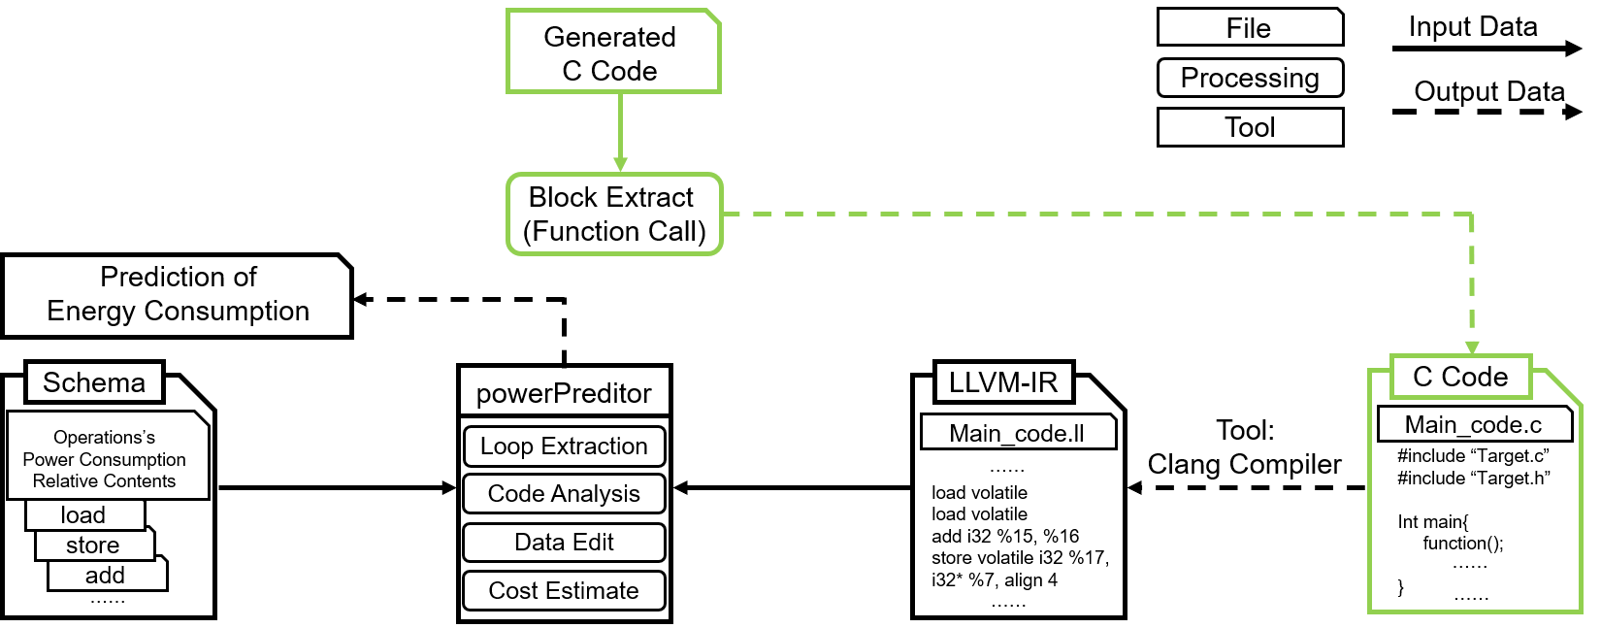
Extracting Working Portion
[Proposed Method]
Function Call
Call the main function section in the generated file by means of a function call in the new c-file

Slide 15
Contribution
[Proposed Method]
［Contribution1］ A schema is proposed to describe the energy consumption of instructions
［Contribution2］ A method is proposed for extracting the working portion from generated code and transforming it into LLVM-IR
［Contribution3］ A software tool is designed to predict model energy consumption

Slide 16
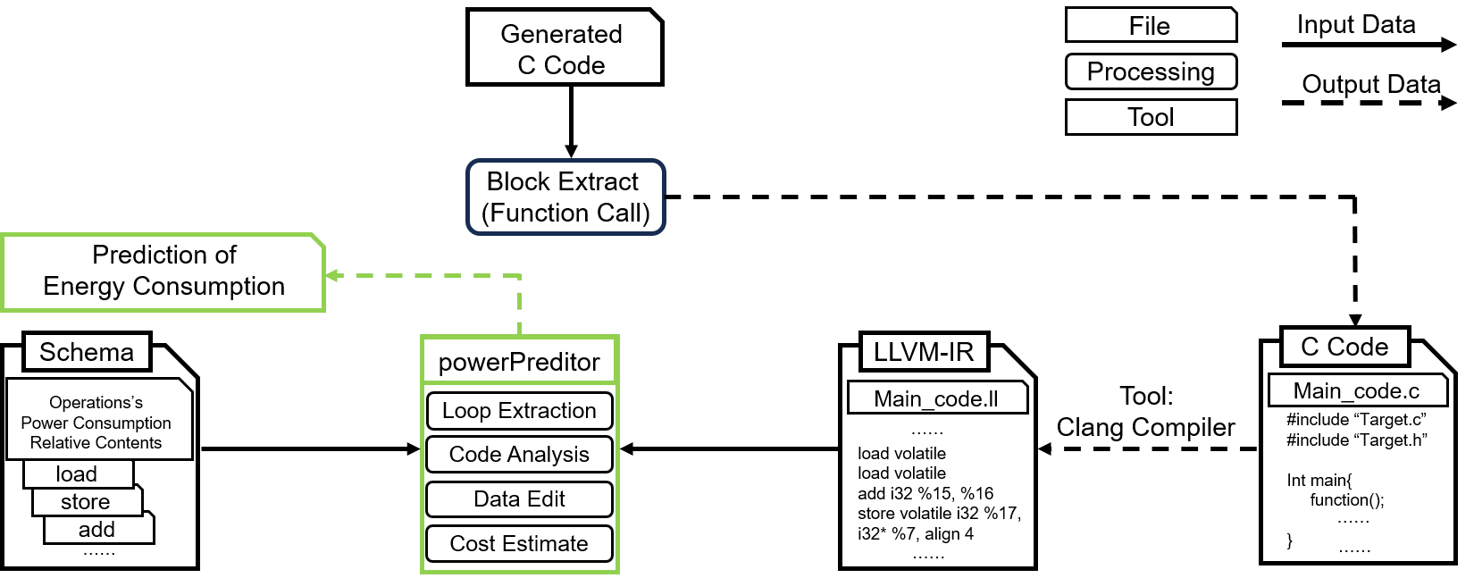
Prediction Tool
[Proposed Method]
Input
Schema
LLVM-IR Code
Output
Prediction of code’s energy consumption

Slide 17
Comparison with Other Methods
[Proposed Method]
 | Modeling | Code Generation | Energy Consumption Measurement | Energy Consumption Prediction
MDD [7] | ○ | ○
Mercury [8] | ○ | ○
IEEE Access [9] |  |  | ○
SDK4ED [10] |  |  | ○ | ○
J4CS [11] |  |  | ○ | ○
PARTSim [12] |  |  | ○ | ○
本研究 | ○ | ○ | ○ | ○
必要なら関連研究との差異や新規性の説明

Slide 18
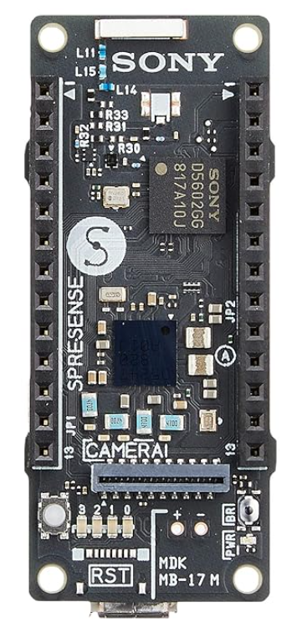
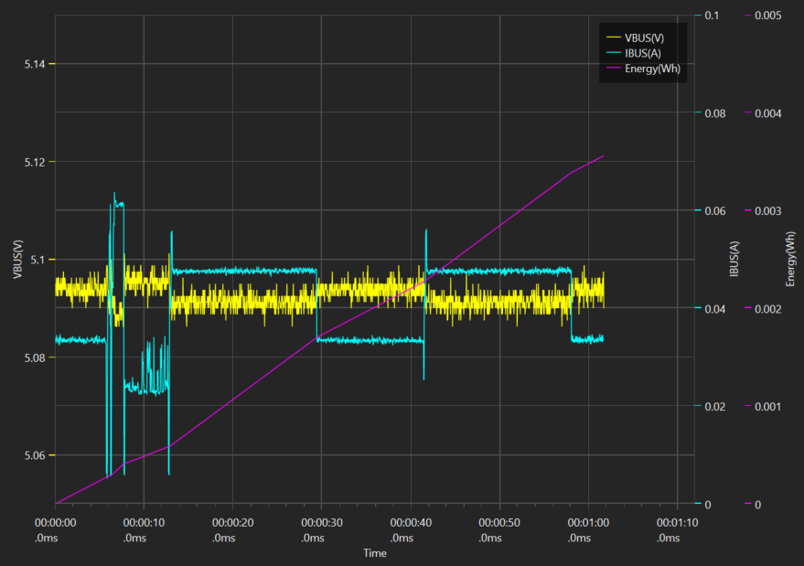
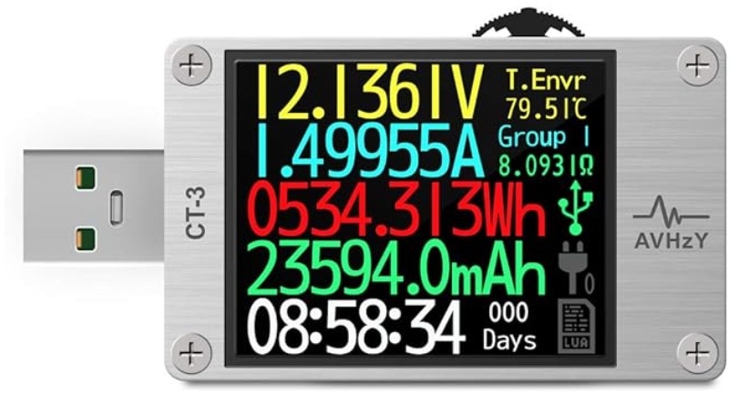
Experimental Environment
[Evaluation]
Target device
SONY Spresense (ARM Cortex M4F)
Measurement device
AVHzY CT-3 USB tester

Slide 19
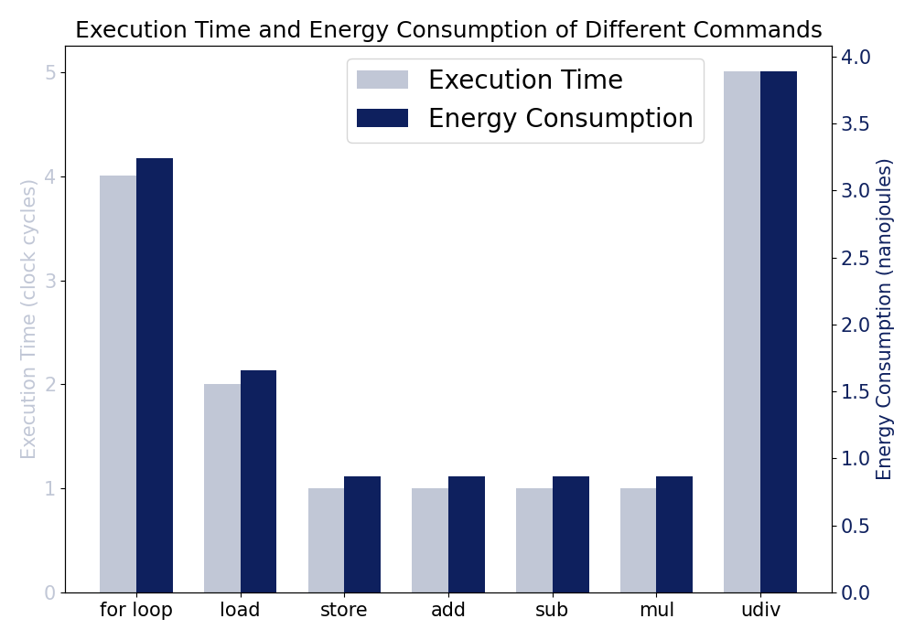
Experimental
[Evaluation]
Basic Evaluation
Measure the power consumption and execution time of basic instructions on the target device
Create test scripts to obtain actual execution time and power consumption in a single core environment
Notes:
Code execution time is closely related to energy consumption, and to predict energy consumption, code time estimation can be synchronized and used as a validation.
To this end, we have listed the following basic evaluations
To guarantee cross-platform and cross-architecture properties, the Low Level Virtual Machine Intermediate Representation (LLVM-IR) code is used in the experiment.
LLVM-IR provides a unified, hardware-independent basic instruction set.
First, it measures the power consumption and execution time of the basic instructions on the target device.
We also create a test script to obtain the actual execution time and power consumption in a single-core environment.
Finally, based on the measured single instruction data, predictions are made at the LLVM-IR instruction level and compared to the measured values to analyze the prediction accuracy.
The figure shows the measured power consumption and execution time of a number of basic instructions. The unit of execution time is cycles, and the unit of energy is nanojoules

Slide 20
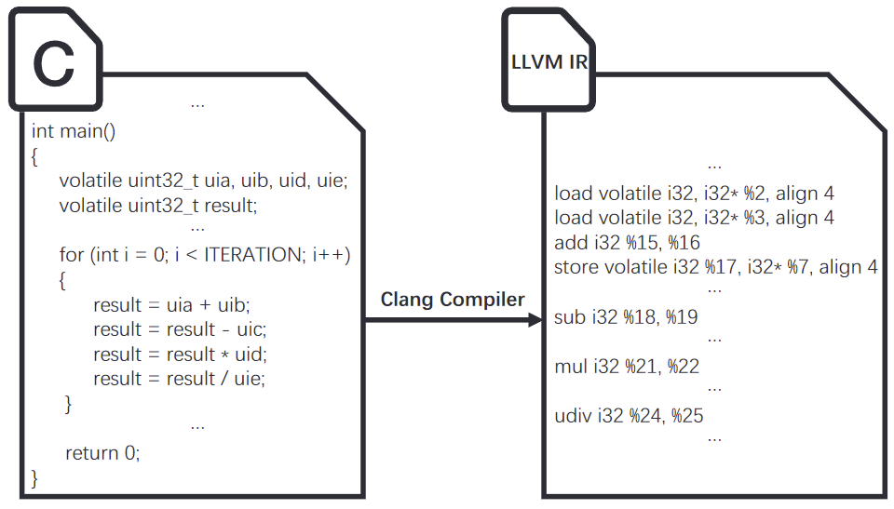
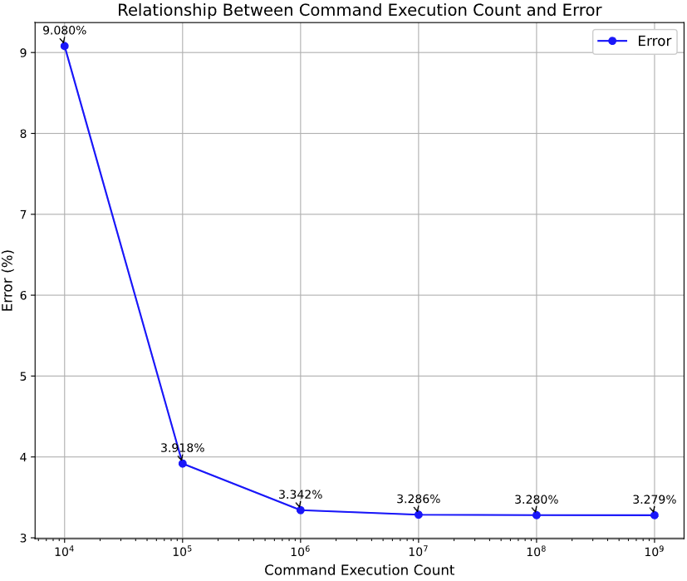
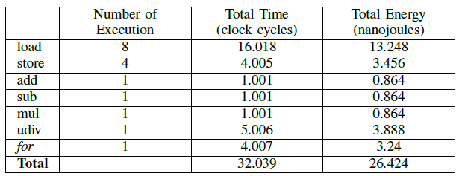
Experimental
[Evaluation]
Basic Evaluation
Test Scripts
Four arithmetic operations（add,sub,mul,div）
Predicting power consumption
Focus on the “for” statement part
Test Scripts
Time and Energy Consumption of Instructions
Power Consumption Prediction Focus on “for”
Notes:
In order to verify the feasibility of our proposed approach
The test script performs a simple four arithmetic operations.
in this case, we focus only on the for statement, so when the number of loops is small, the error is large.As the number of loops is increased, the error gradually decreases.

Slide 21
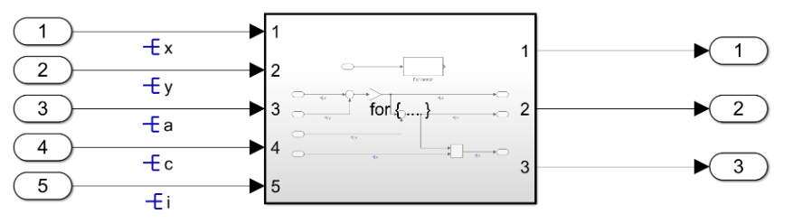
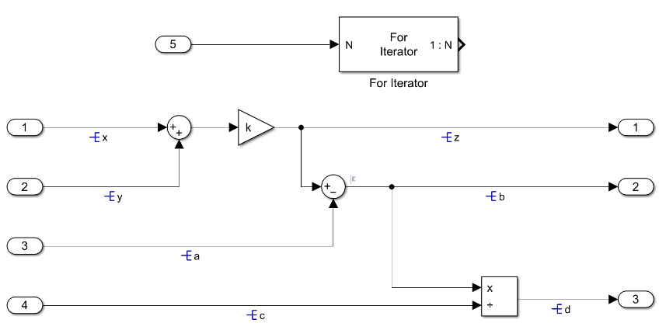
Experimental
[Evaluation]
Evaluation with Models
Overall Model Construction
For Iterator Subsystem Construction
Notes:
In addition, an evaluation using a model was conducted to determine if the proposed schema and estimation method are applicable in model-based development.
The model we prepared is shown in the figure below, using the for subsystem to perform the four arithmetic operations.
In the actual case, the model works by receiving information from the outside and passing it to the model after the process is complete, and the test model is also used in the function call.

Slide 22
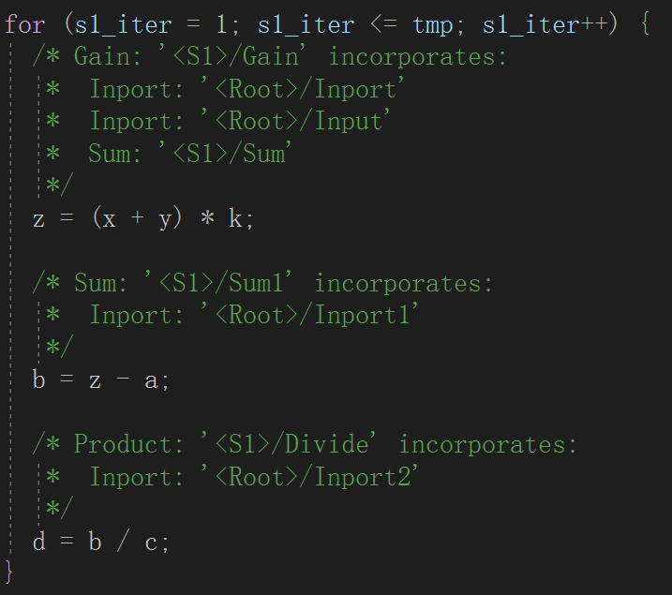
Experimental Environment
[Evaluation]
Evaluation with Models
Code generated by Embedded Coder
Execute in user code with function calls
Convert to LLVM-IR instructions
Make predictions with a prediction tool
Notes:
Once the model has been created, Embedded Coder generates the code.
The for statement part of the generated code is shown in the figure on the left
.Next, it writes in the user's code with a function call
Finally, the actual power consumption is calculated by writing to the target device.

Slide 23
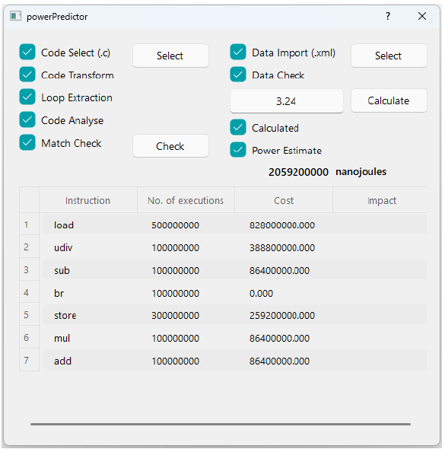
Experimental Environment
[Evaluation]
Evaluation with Models
Result
Prediction
2,059,200,000 nJ
Measurement
1,980,000,000 nJ
Error: 4%
Error Analysis
Precision of the equipment
1,000 times per second
Notes:
The prediction part converts the user code into LLVM-IR instructions, and the prediction is performed by the designed prediction tool.
The resulting error between actual and predicted power consumption is found to be 4%.

Slide 24
＜サブタイトル＞
[今後の展望]
今後の展望については，最終発表では隠しスライドにする

Slide 25
Conclusion
Background
Development of edge devices is becoming complex
The reusability of the code developed with traditional method is limited
Energy consumption of system is ignored in MBD
Proposed Method
Schema Construction: a structured approach to modeling energy usage
Module Extraction: parts of the model relevant to energy consumption
Energy Consumption Prediction Tool: software to predict energy usage
Contribution
provides a robust method for estimating energy requirements in embedded systems
Evaluaion
Basic evaluation with test scripts
Evaluation with models
Notes:
まとめは以下のようになっています。
発表は以上です。

Slide 26
＜サブタイトル＞
[補足資料]

Slide 27
新規性は何ですか?

Slide 28
何が難しいんですか?

Slide 29
実装で何が難しかったですか?

Slide 30
既存研究と比べて何が良いんですか？

Slide 31
既存研究で提案手法が使われないのは何故?

Slide 32
どこまでが自分で提案した部分ですか

Slide 33
何故この研究をやろうと決めたのですか？

Slide 34
この研究に必要性はあるのか？

Slide 35
想定しているユーザは誰ですか？

Slide 36
工夫したことは何ですか？

Slide 37
その評価を選んだ理由は何ですか？

Slide 38
評価は優位的な差があると言えるのか?

Slide 39
今後の展望などはありますか？

